Slide 1

Modelling Air Pollutants in Major Construction Zones in Downtown Toronto
Markus Kunej
Supervisor: Professor Greg Evans

Slide 2


Background
42% increase of total suspended particulates (TSP) near construction zones¹
Construction workers more likely to develop Chronic Obstructive Pulmonary Disease (COPD)²
Emission rates vary with construction activity and weather³
Past attempts to model/predict these pollutant levels can be improved⁴
Lack of meteorological data
Modelling a single pollutant at a time (not accounting for possible interdependencies)
[1] H. Yan, G. Ding, H. Li, Y. Wang, L. Zhang, Q. Shen, and K. Feng, “Field evaluation of the dust impacts from construction sites on surrounding areas: A city case study in China,” Sustainability, vol. 11, no. 7, p. 1906, 2019.
[2] I. A. Bergdahl, K. Torén, K. Eriksson, U. Hedlund, T. Nilsson, R. Flodin, and B. Järvholm, “Increased mortality in COPD among construction workers exposed to inorganic dust,” European Respiratory Journal, vol. 23, no. 3, pp. 402–406, 2004.
[3] Y.-M. Chang, T.-C. Chang, and W.-K. Chen, “An estimation on overall emission rate of fugitive dust emitted from road construction activity,” Environmental Engineering Science, vol. 16, no. 5, pp. 375–388, 1999.
[4] H. Li, A. Cheshmehzangi, Z. Zhang, Z. Su, S. Pourroostaei Ardakani, M. Sedrez, and A. Dawodu, “The correlation analysis between air quality and construction sites: Evaluation in the urban environment during the COVID-19 pandemic,” Sustainability, vol. 14, no. 12, p. 7075, 2022.
Notes:
Urban densification can have a positive impact on the environment, by bringing people closer to work and reducing overall landtake. However, the major construction sites needed during this process are associated with a higher levels of air pollution. A case study in China, found the daily concentration of total suspended particulates (TSP) near a construction site increased by over 42%.
A different study in Sweden analyzed over 300,000 construction workers from 1971 to 1999, and found that over 52% of the cases of Chronic Obstructive Pulmonary Disease can be attributed to airborne exposure at work.
The emission rates of pollutants was also observed to vary with weather, and increased during construction working hours.
A past attempt to model air pollutants to the number of construction sites did not produce definite results They cited the lack of weather data in the model as a weakness. They also modelled each pollutant individually, not accounting for possible relationships between them.

Slide 3
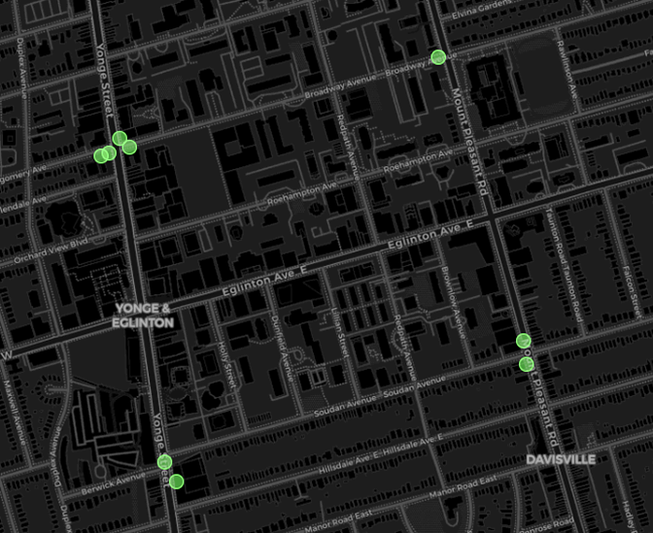

Objectives
Location of 10 AirSENCE Units
Improve forecasting of air pollutant levels in construction zones
Why?
Construction companies can plan activity according to the forecast to minimize risk to workers and residents
How?
10 AirSENCE units near Yonge & Eglington Construction Hub
Incorporate meteorological data (Humidity, Temperature, Wind Speed, etc.) and construction activity (Noise)
Treat as Multivariate Time Series Problem
CO, CO2, NO, NO2, O3, PM1, PM10, PM2.5, Humidity, Noise, Pressure, Temperature, Wind Direction, Wind Speed
Notes:
The aim of my thesis was to improve past attempts of modelling air pollutant levels in construction zones.
Why?
With an accurate forecast and understanding of what causes increases in certain air pollutants, construction companies can plan their activity in order to minimize the amount of air pollution being created.
How would I achieve this?
Using the data collected by the 10 AirSENCE devices near the Yonge & Eglington Construction Hub. They capture meteorlogical and noise level data, which can be incorporated to the model to improve upon past attempts.
I will treat this as a MultiVariate Time Series Problem, modelling the different air pollutants and weather data all together.
Here is a full list of the variables used when modelling, and the first 8 air pollutants are the ones we are trying to predict.

Slide 4

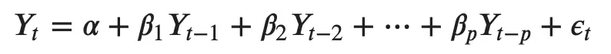
Methods
Vector Autoregressive (VAR) model:
Vector Autoregressive Moving Average (VARMA) model:
Sobol Sensitivity Analysis
Generate Impulse Responses using Saltelli Sampling⁵
[5] Global sensitivity analysis: The Primer. Hoboken, NJ: John Wiley &amp; Sons, 2008.
Notes:
Two models commonly used for such multivariate time series problems are Vector Autoregressive and Vector Autoregressive with Moving Average.
In a Vector AutoRegressive model, each variable has an equation modelling its evolution over time. It includes the variable’s lagged (past) values, the lagged values of all other variables in the model, and an error term.
The Vector AutoRegressive with Moving Average expands upon the first model, by including a Moving Average Component to the equation. A Moving Average model only uses past error (or residual) terms to predict future values. The order of both the autoregressive part (p) and moving average part (q) can be customized.
Another powerful tool to learn about relationships between variables in a model is Sensitivity Analysis. You generate samples to input into model that will test how the model reacts to impulses from a single variable or two of them together. It tells you how sensitive a variable is to changes in a different variable.

Slide 5
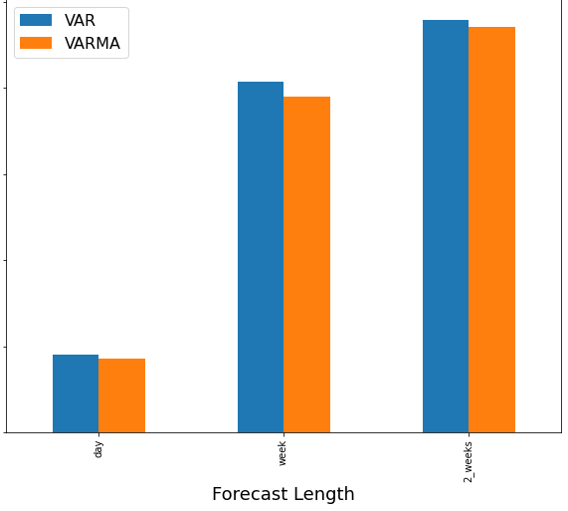
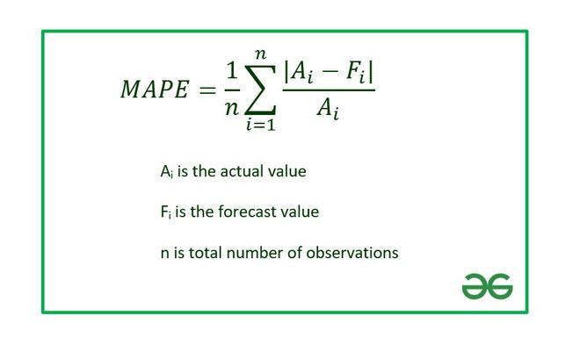
Results – Model Type
Vector Autoregressive with Moving Average Predicts with Less Error
100%
80%
60%
Mean Absolute Percentage Error
40%
20%
https://www.geeksforgeeks.org
0%
Notes:
First I wanted to see whether adding the moving average component to the vector autoregressive model improved predictions. The Metric I used to compare different models was the Mean Absolute Percentage Error. It’s important I used a percentage-based error for the metric, since I am forecasting for a variety of air pollutants, some of them (like Carbon Dioxide) have naturally much higher values, so we don’t want biases in the comparison.
As you can in the graph, both models were able to forecast the next day for the 8 air pollutants with only around 20% error, but this grows drastically when attempting longer range forecasts, like a week or 2 weeks ahead. The model with both the autoregressive and moving average component, shown in orange, slightly outperformed the one without the moving average part, so we will use this one going forward.

Slide 6
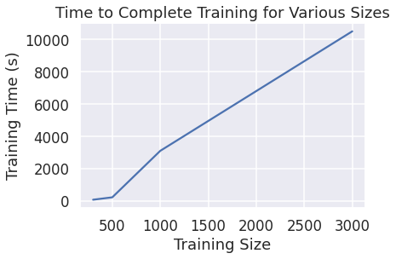
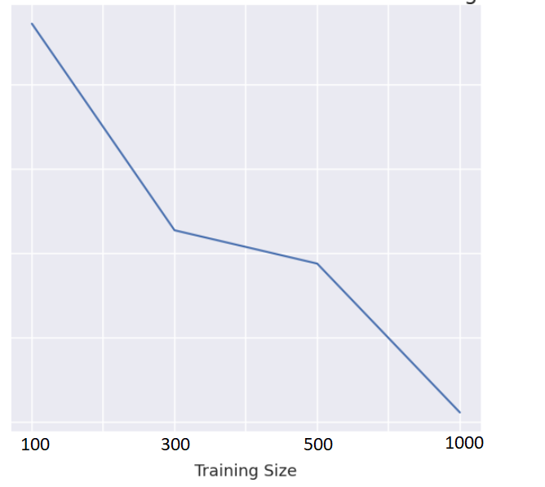
Results – Training Size
Increasing the Training Size Reduces the Model Error
Increasing the Training Size Increases the Time to Train
Nitrogen Monoxide
35%
30%
Mean Absolute Percentage Error
25%
20%
Unable to train beyond 3000 data points for VAR, 1000 data points for VARMA
15%
Notes:
Training size refers to the number of data points I used. This first graph was created using 15 min resolution data, so each point represents 15m of time. Generally, the error decreased as I increased the training size used for the model. This first graph demonstrates that, showing the error of Nitrogen Monoxide for a 1 week forecast range using 4 different training sizes.
However, the time it took to complete training also increased with the training size. The second graph shows that for the vector autoregressive models.
This created a limitation, where trying to train an autoregressive with moving average model beyond 1000 datapoints was difficult due to the long training time and computation limits.

Slide 7
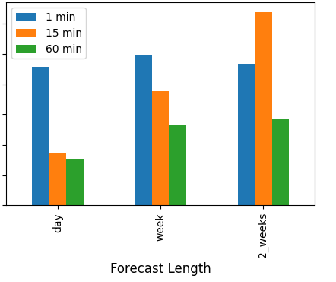
Results – Measurement Resolution
Higher Time Resolution Data Produces Lower Forecast Error
NO₂
60%
50%
1000 x 1 min = 16.7 hours
40%
Mean Absolute Percentage Error
30%
1000 x 60 min = 41.7 days
20%
10%
0%
Notes:
Next, I wanted to determine what the best resolution of data was for forecasting. The Grafana interface that received the data from the devices gave several options of data resolution, such as 1, 15, or 60 min.
With the training size fixed at 1000, the higher time resolution data produced the lowest errors, as you see with the graph for Nitrogen Dioxide.
This makes sense given the limit of 1000 data points. For the 1 min frequency it’s only ~16 hours worth of data, but for the 60 min frequency data that is more than 40 days worth of data. You can imagine it’s hard for a model to learn about daily cycles if it doesn’t even have a full day’s worth of data to train on.

Slide 8
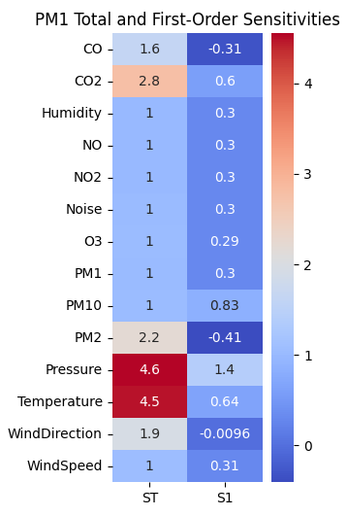
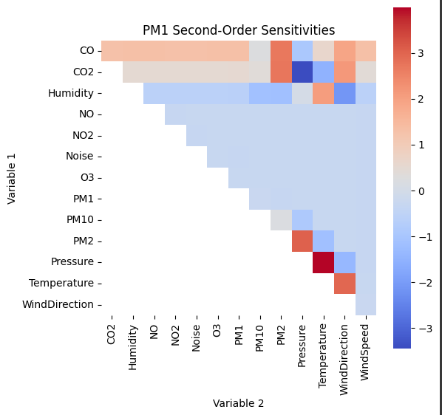
Results – Sensitivity Analysis
Responding Pollutant | Top Total Sensitivity
PM1 | Pressure
PM2 | CO2
PM10 | Pressure
CO | Wind Direction
CO2 | Humidity
O3 | CO
NO | NO2
NO2 | Wind Direction
Notes:
Next I performed sensitivity analysis on the highest performing model.
Positive sensitivity indices indicate as the input parameter increases, the output variable will either increase or decrease consistently.
Negative Sensitivity Values indicate that the input parameter is not important for the output of the model
(CLICK)
This first heatmap shows the total-order sensitivities in the first column, and first order sensitivities in the second one for Particulate Matter smaller than 1 microns wide. You can see both Pressure and Temperature had the greatest affect on the resulting predictions. But the Total order sensitivity is much higher than the first order one, suggesting higher order relationships are at play.
If the total sensitivity index is higher than the first-order sensitivities, it suggests that there are interactions between the input parameters that should be taken into account when analyzing the model or designing experiments.
(Click)
We that here in the second order sensitivities, where Pressure with Temperature, Temperature with WindDirection, and Particulate Matter 2.5 with Pressure, were the most impactful pairs on particulate matter 1 predictions.
(Click)
The table shows the variable each responding pollutant is most sensitive to, which are the ones with the greatest total sensitivity. Whether these relationships are real, or due to interference of the AirSENCE sensors is something to consider. For example, I’ve been told that Humidity can interfere with the CO2 sensor, potentially explaining that sensitivity, however the other sensitivities are more likely “real”, suggesting relationships between variables and weather.
It’s important to remember these results are model specific. Gives insights into model, but the model may not be accurate of real life. In our case, the model was able to predict daily forecasts with only about 20% error, but long-term forecasts were inaccurate, so these sensitivies should only be considered for short-term changes.

Slide 9
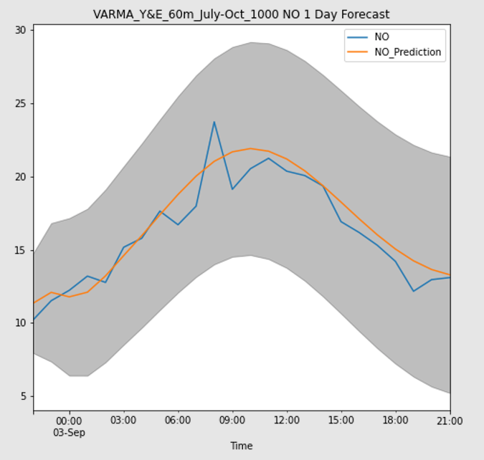
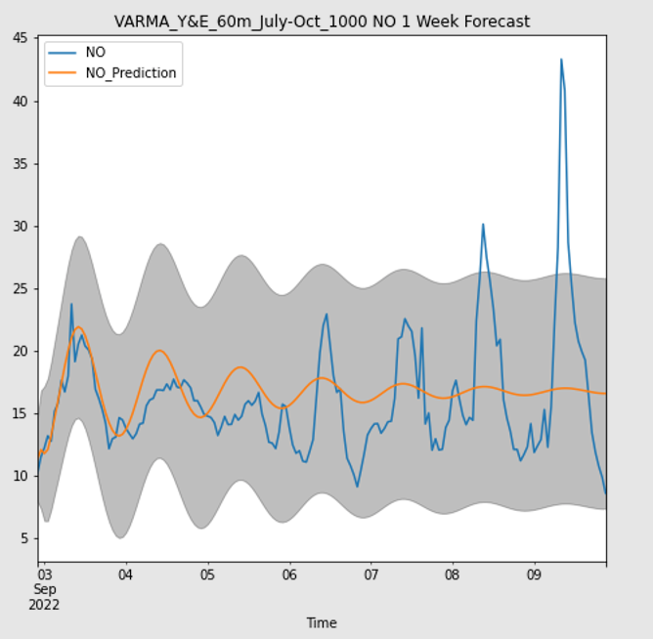
Results – Discussion
Short-term Forecasts Fairly Accurate
Long-term Forecasts Trend Towards Historic Mean
µg/m³
µg/m³
Notes:
Another interesting result with the forecasts is their tendency to converge to the historical mean for long-term predictions. Even when daily cycles can be observed, it elects to flatten out the predictions. This could be a result of the difficulty of the task of modelling 14 different variables together, with no external or known variables to assist with predictions other than the past values. Also the random nature of weather can make forecasts difficult.

Slide 10

Future Work
Train on longer periods of time
Use a more powerful computer
Reduce Dimensions
Johansen Co-Integration
Granger Causality
Expert Opinion
Model using Feedforward Neural Networks
Can still perform sensitivity analysis
Notes:
To try to improve forecasts for longer time horizons, I believe training on a larger dataset can improve it’s chances to learn of daily, weekly, and even seasonal patterns.
There was a computation limit that didn’t allow for more than 1000 training points. In the future, I can look into using a more powerful computer.
But perhaps the better option is to look into reducing the dimension of the model, by decreasing the 14 variables into something smaller. This would make training quicker because there are less equations needed to learn during training.
You can do this through Johansen Co-Integration, where you look for variables that closely correlate to each other and combine them into a single variable.
You can also look at which variables “cause” others through a granger causality test. The Variables which do not appear to cause changes to the target variable can be removed from the model.
Lastly you can ask for expert opinion as a quick way to remove unnecessary variables.
Another type of model that can be used to better learn some of the complex higher order relationships between variables could be feedforward neural networks. This would be recurrent neural networks.
While the inner parameters of such a model would not be interpretable, you can still perform sensitivity analysis to determine the impulse responses of each variable, allowing for some understanding.

Slide 11
Summary
Best Model Type: Vector Autoregressive with Moving Average
Best Training Size: 1000 data points (vectors)
Best Data Resolution: 60 minutes
Sensitivity Analysis
Achieved Objective?
Responding Pollutant | Top Total Sensitivity
PM1 | Pressure
PM2 | CO2
PM10 | Pressure
CO | Wind Direction
CO2 | Humidity
O3 | CO
NO | NO2
NO2 | Wind Direction
Notes:
As a summary, the Vector Autoregressive with Moving Average model performed slightly better than just the Vector AutoRegressive model.
The forecast error decreased as the size of the training set increased, but a limit of 1000 data points (vectors in our case) was observed due to computation stresses
Using a larger data resolution, 60 minutes, performed better than the smaller resolutions of 1 min and 15 min.
Sensitivity Analysis showed us which variables each pollutant was most sensitive to, and often times it was a combination of 2 variables that produced the largest sensitities.
Did we achieve the initial objective of improving forecasting in construction zones. I would say not to the degree needed for construction companies to plan their activity around it, since the forecasts were only accurate up to a couple of days. But the sensitivity results do suggest there are interdependencies amongst the variables, and when combined with the steps I outlined to increase the training time , can potentially lead to further improvements.

Slide 12
Questions?
markus.kunej@mail.utoronto.ca
https://github.com/markuskunej/air-pollution-thesis

